Slide 1
SPORT PROJECT
PART 1

Slide 2
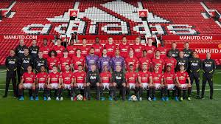
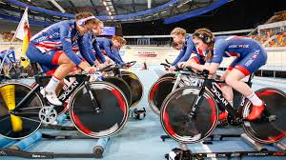
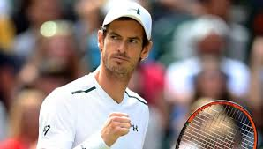
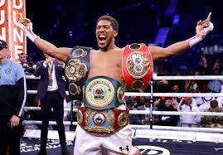
Introduction
Over the next few weeks you are going to be asked to complete a number of tasks based around a professional/high level sports team of your choosing e.g. Manchester united, the British cycling team or an individual performer that will have a supporting team around them.
The first project will look at 2 main areas: ‘anatomy and physiology’ and ‘health and fitness training’.
YOU WILL NEED TO DO SOME RESEARCH TO
COMPLETE THE TASKS. use the link on each
page as a starting point.

Slide 3
DEADLINES
Once you have completed the tasks you need to send them to either:
MR Stapleton - Taran.Stapleton@qka.education if applying for QKA
MRS brown – becky.brown@tda.education if applying for tda
By Friday 19th june

Slide 4
Anatomy and physiology
task 1 – MOVEMENT ANALYSIS
For the sport you have chosen identify 3 simple skills that are performed. for the execution phase complete a table that includes the following information:
DESCRIBE THE MOVEMENT THAT IS TAKING PLACE DURING EACH SKILL USING SOME OF THE FOLLOWING WORDS: FLEXION, EXTENSION, ABDUCTION, ADDUCTION, ROTAION AND CIRCUMDUCTION. (YOU CAN ADD THIS AS A COLUMN ON THE END OF YOUR TABLE OR IN A SEPARATE PIECE OF WORK.)
https://www.bbc.co.uk/bitesize/guides/zcptycw/revision/1
SKILL | BONES INVOVLED | MUSCLES INVOLVED | JOINT/S INVOLVED

Slide 5
Anatomy and physiology
task 2 – CIRCULATORY AND RESPIRATORY SYSTEMS
PICK A PERFORMER ON YOUR TEAM AND COMPLETE ONE OF THE FOLLOWING TASKS
OPTION 1 – DISCUSS HOW THEIR HEART RATE AND BREATHING RATE WOULD CHANGE AT DIFFERENT POINTS IN THEIR PERFORMANCE.
OPTION 2 –DISCUSS HOW THEIR HEART RATE AND BREATHING RATE WOULD DIFFER DURING A PERFORMANCE IN COMPARISON TO SOMEONE PERFORMING IN A DIFFERENT POSITION. E.G. CENTRE VS GOALKEEPER IN NETBALL
https://www.bbc.co.uk/bitesize/guides/z367tyc/revision/1

Slide 6
HEALTH AND FITNESS TRAINING
TASK 1 – LIFESTYLE ANALYSIS
PICK A PERFORMER ON YOUR TEAM AND A ‘normal’ ADULT you know quite well. using the following headings compare the two people you have selected against each other and assess these impact areas these would have on their health.
exercise/physical activity
diet
smoking/alcohol/drugs
stress
sleep
https://www.bbc.co.uk/bitesize/guides/z3shycw/revision/2
https://www.bbc.co.uk/bitesize/guides/z3shycw/revision/3

Slide 7
HEALTH AND FITNESS TRAINING
TASK 2 – fitness training
for the performer you have selected pick 2 components of fitness that you think are the most important to their position then:
evaluate why you think they are most important to this performer
identify what training methods would you use to improve their performance in these areas
https://www.bbc.co.uk/bitesize/guides/z2b9q6f/revision/2

