Slide 1
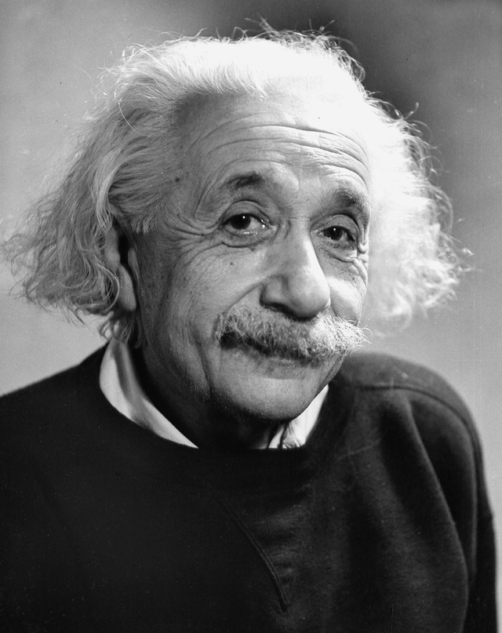
Transition from GCSE to A-level Physics
“Time is relative, it worth depends only on what we do as it is passing”
Albert Einstein

Slide 2
Contents of this PowerPoint
Slides 3-6 Mathematical skills
Slides 7-9 Mathematical skills – test yourself
Slides 10-12 Calculations
Slides 13-14 Calculations – test yourself
Slides 15-19 Experimental skills
Slides 20-24 Experimental skills – test yourself
Slides 25-28 Extra reading and resources
Slides 29-31 Why Physics?

Slide 3
Mathematical skills – Using numbers
“Not everything that can be counted, counts and not everything that counts can be counted”
Albert Einstein

Slide 4
Prefixes
Symbol | Name | What it means |  | How to convert
P | peta | 10¹⁵ | 1000000000000000 |  | ↓ x1000
T | tera | 10¹² | 1000000000000 | ↑ ÷ 1000 | ↓ x1000
G | giga | 10⁹ | 1000000000 | ↑ ÷ 1000 | ↓ x1000
M | mega | 10⁶ | 1000000 | ↑ ÷ 1000 | ↓ x1000
k | kilo | 10³ | 1000 | ↑ ÷ 1000 | ↓ x1000
 |  |  | 1 | ↑ ÷ 1000 | ↓ x1000
m | milli | 10⁻³ | 0.001 | ↑ ÷ 1000 | ↓ x1000
μ | micro | 10⁻⁶ | 0.000001 | ↑ ÷ 1000 | ↓ x1000
n | nano | 10⁻⁹ | 0.000000001 | ↑ ÷ 1000 | ↓ x1000
p | pico | 10⁻¹² | 0.000000000001 | ↑ ÷ 1000 | ↓ x1000
f | femto | 10⁻¹⁵ | 0.000000000000001 | ↑ ÷ 1000
Physics deals with quantities from the very large to the very small.
A prefix is something that goes in front of a unit and acts as a multiplier.

Slide 5
Using Index notation
In GCSE it is acceptable to give units in this form m/s
However A-level uses index notation so:
m/s becomes m s⁻¹ and m/s² becomes m s⁻²
A space is left between different units but no space between a prefix and units.

Slide 6
Significant figures
All non-zero numbers ARE significant.
Zeros between two non-zero digits ARE significant.
Leading zeros are NOT significant. They're nothing more than "place holders.”
Trailing zeros when a decimal is shown ARE significant.
Trailing zeros in a whole number with no decimal shown are NOT significant.

Slide 7
Test your knowledge
s | ms | μs | ns | ps
0.00045 | 0.45 | 450 | 450 000 or 450 x10³ | 450 x 10⁶
0.000000789
0.000 000 000 64
Convert your figures into the prefixes required

Slide 8
Test your knowledge
mm s⁻¹ | m ms⁻¹ | m s⁻¹ |  | ms⁻¹
What do the units and prefixes above mean?

Slide 9
Test your knowledge
Value | Sig Figs | Value | Sig Figs
1066 |  | 1800.45
82.42 |  | 2.483 x 10⁴
750000 |  | 0.0006
310 |  | 5906.4291
3.10 x 10⁴ |  | 200000
3.1 x 10² |  | 12.711
How many significant figures?

Slide 10
Calculations
“It’s not that I’m smart, I just stay with problems for longer.”
Albert Einstein

Slide 11
Rearranging equations
The most important rule for algebra is: If you do something to one side of an equation, you have to do it to the other side too.
An equation basically says “the stuff on the left hand side of the equals sign has the same value as the stuff on the right hand side of it,” like a balanced set of scales with equal weights on both sides.
If you want to keep everything equal, anything you do needs to be done to both sides.
E.G V = I R, what would I be?
V = I R
R R
V = I R
R R
V = I
R
I = V
R
V = I R
Therefore
Or
R / R cancels R

Slide 12
Gradients
Gradients are a useful tool that show how fast or slow quantities change
To calculate the gradient, pick any two points on the line as far away as possible and draw a large triangle between them.
The gradient is given by:
$gradient= \frac{diffference in y values}{difference in x values}$
Remember – if the line slopes up, the gradient should be positive; if the line slopes down, then the gradient should be negative.

Slide 13
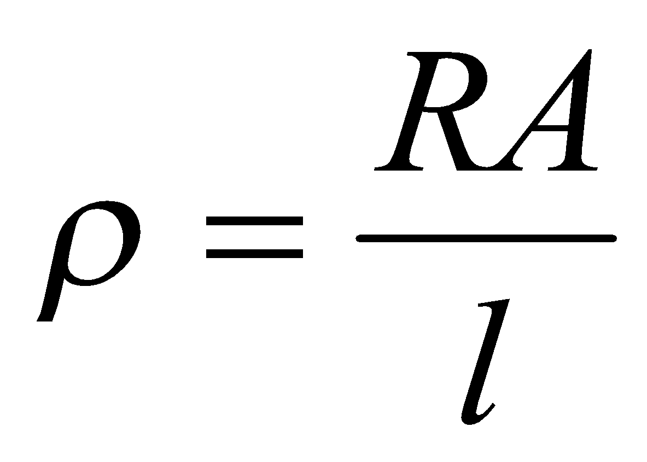
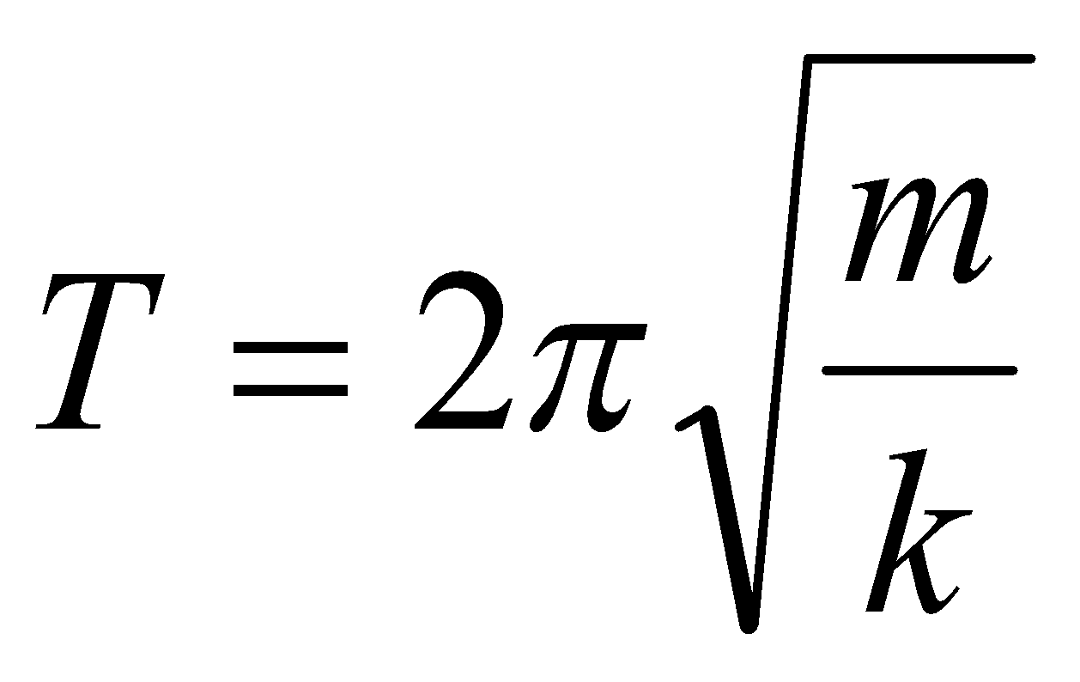
Test your knowledge
Equation | Rearrange equation
 | r
 | A
 | m
 | u
 | k
Rearrange the equations above

Slide 14
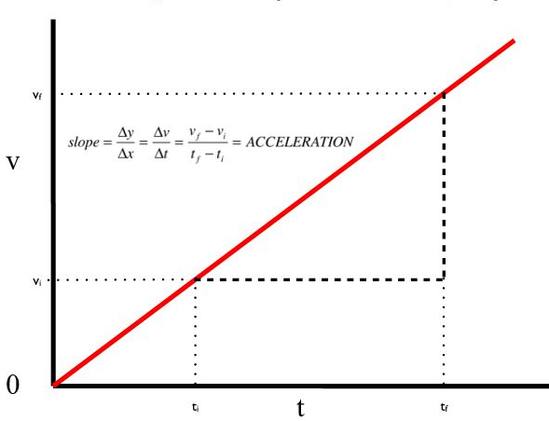
How could this gradient be best described?
Test your knowledge

Slide 15
Experimental skills and terms
“It is theory that decides what can be observed.”
Albert Einstein

Slide 16
Tabulation
Key Points
Headings should list the variable tested, or the equation being performed and the unit. The unit should NOT be repeated with the values
The left hand column would normally record the independent values and the other columns those measured or calculated.
Repeats and average columns should ALL contain both the variable and unit in the heading as shown below.
Independent variable
Dependent variable
Unit
Time / s | Distance travelled / cm
0 | 0
60 | 46
120 | 70
180 | 85
240 | 94
300 | 96
360 | 96
420 | 96
Values, these should be written to the level of precision allowed by the equipment used.
A / used instead of brackets
Time / s | Distance travelled / cm
 | Attempt 1 | Attempt 2 | Attempt 3 | Average
0 | 0 | 0 | 0 | 0

Slide 17
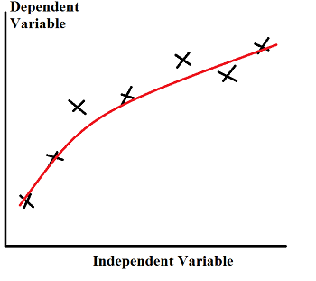
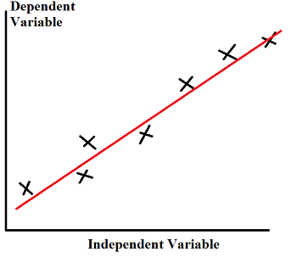
Graphs skills
When drawing lines of best fit, draw a smooth straight or curved line that passes through the majority of the points. If you can, try to have an even number of points above and below the line if it can’t go through all points.

Slide 18
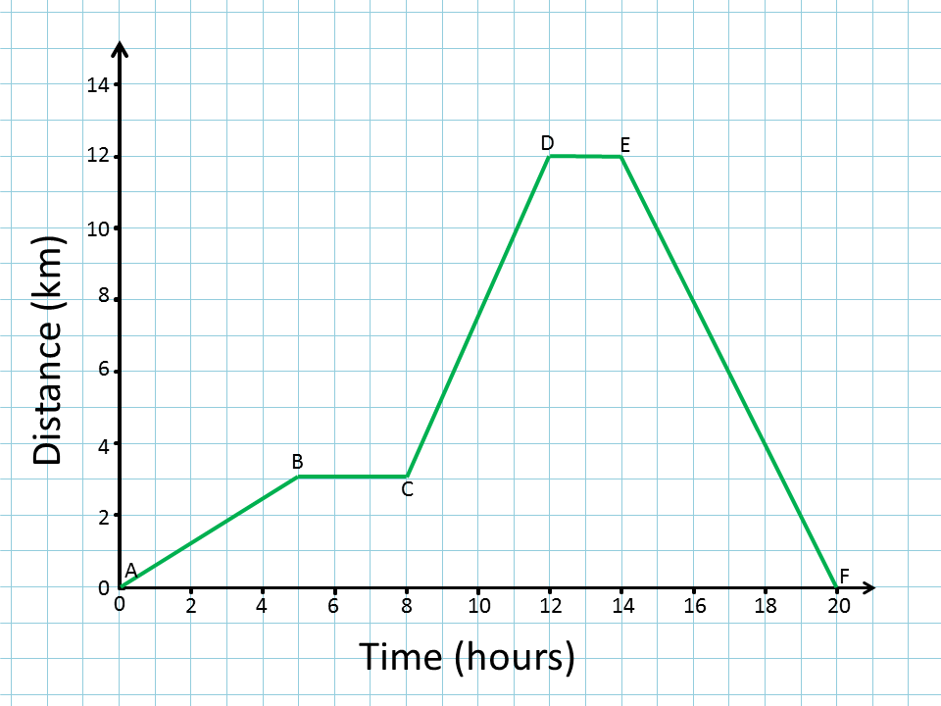
Describing graphs
Usually the x axis plots the independent variable and the y axis plots the dependent variable.
When describing the trend, use the phrase….
“As ‘X’ increases, ‘Y’ increases/decreases in a linear/non-linear fashion.”
Substitute the quantities into X and Y, and choose either of the two options to describe the graph.
“Between A and B, as time increases, distance increases in a linear fashion.”

Slide 19
Experimental Key terms
Accuracy is the proximity of measurement results to the true value
Precision is both the ability of a measurement to be consistently reproduced and the number of significant digits to which a value has been reliably measured.
Reproducible - A measurement is reproducible if the investigation is repeated by another person, or by using different equipment or techniques, and the same results are obtained.
Repeatable - A measurement is repeatable if the original experimenter repeats the investigation using same method and equipment and obtains the same result.
Variable is any factor that can be controlled, changed, or measured in an experiment.

Slide 20
Test your knowledge
Month of the year | Angle of tilt |  |  | Average
 | 20 | 30 | 40
Feb | 460 | 500 | 480
Apr | 600 | 620 | 610
Jun | 710 | 720 | 680
Aug | 640 | 660.00 | 640
Oct | 480 | 520 | 500
Dec | 400 | 440 | 420
What is wrong with the table shown? (Four to find)

Slide 21
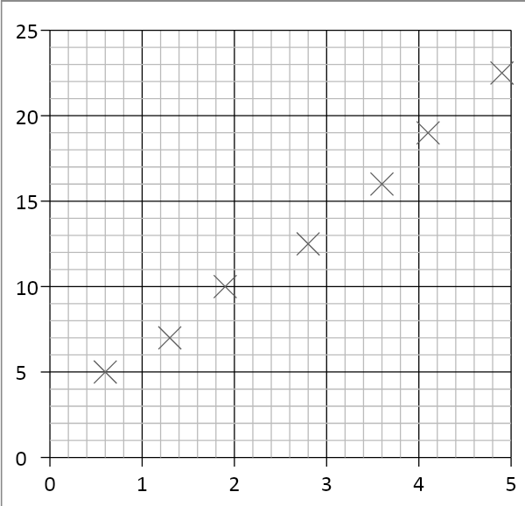
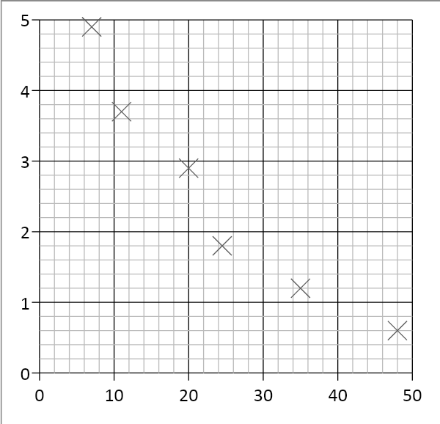
Test your knowledge
Draw lines of best fit for both of the graphs shown above

Slide 22
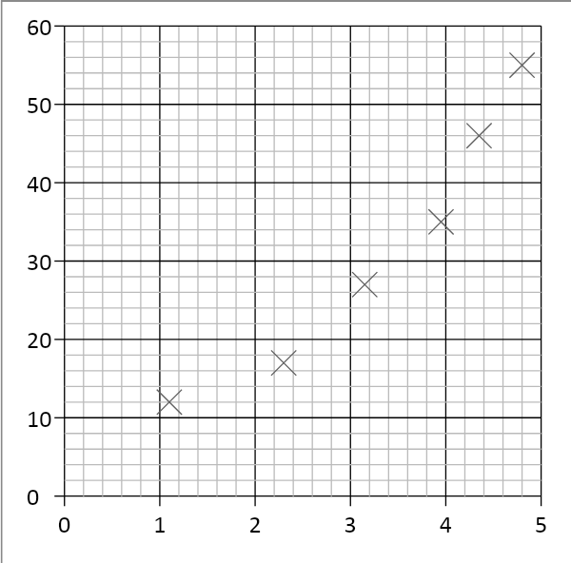
Test your knowledge
Draw lines of best fit for both of the graphs shown above

Slide 23
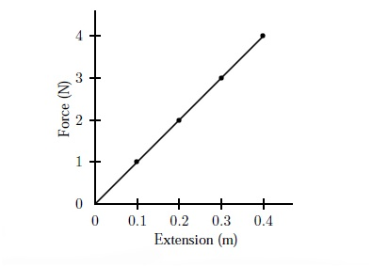
Test your knowledge
What is it about a Hooke’s Law graph that makes the trend on the graph more difficult to describe?

Slide 24
Test yourself
Key term |  | Definition
Accuracy |  | The same pattern of results are obtained by another person
Repeatable |  | the ability of a measurement to be consistently reproduced
Precision |  | the proximity of measurement results to the true value
Reproducible |  | The same pattern of results are obtained by a different person
Mix and match the key terms with their definitions

Slide 25
Extra reading and resources
“I love to travel, I hate to arrive.”
Albert Einstein

Slide 26
Books and Content relevant to A-level Physics
For a good start:
Head Start to A-level Physics (CGP A-Level Physics) – This is free to Kindle subscribers
Texts
A Level Physics by Roger Muncaster
ISBN 978-0748715848
A Student's Guide to Waves by Daniel Fleisch
ISBN 978-1107643260

Slide 27
Helpful websites
Institute of Physics
http://www.iop.org/tailored/students/
The student room
https://www.thestudentroom.co.uk/
New Scientist
https://www.newscientist.com/

Slide 28
Relevant books to read
Books for enjoyment
A short history of nearly everything by Bill Bryson,
ISBN 978178461859
Why does E=mc²? By Professor Brian Cox and Jeff Forshaw
ISBN 9780306817588
What If?: Serious Scientific Answers to Absurd Hypothetical by Randall Munroe
ISBN 9781848549593

Slide 29
Why Physics?
“Try not to become a man of success, but rather try to become a man of value.”
Albert Einstein

Slide 30
Physics makes you think about why things behave how they do

Slide 31
Some careers that Physics can lead to
Geophysicist/field seismologist
Healthcare scientist, medical physics
Higher education lecturer or secondary school teacher
Radiation protection practitioner
Research scientist (physical sciences)
Scientific laboratory technician
Meteorologist
Engineering
Product/process development scientist
Systems developer
Nanotechnology

