Slide 1
Thomas Deacon Academy Project 2
A LEVEL TRANSITION projects

Slide 2
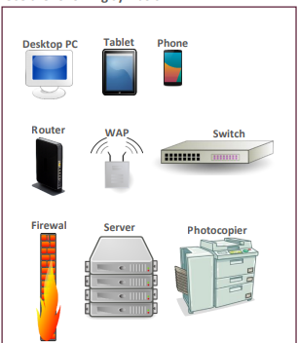
3 Types of networks
Networks task
Carry out some research on computer networks, in particular LANs, WiFi, Network topologies and connectivity devices.
Use the symbols right (feel free to revise them) to create an appropriate
network over the floorplan on the next slide.
Make sure your network meets all the following requirements:
1. Each member of the main office needs a desktop PC
2. Angela, Pam, Dwight and Oscar also use an office issued smart phone
3. The following rooms new access to WiFi:
1. Meeting room (top right)
2. Reception
3. Conference Room
4. Main office
4. Use a circle with a transparent fill (so you can see the network underneath) with a width and height of 12.5cm to provide the WiFi coverage needed to cover the rooms above:
1. The circles need to have a WAP at the centre
2. The 12.5cm diameter circles represent the maximum range of each WAP
3. They WAP icons must be attached to a wall
4. You must use the minimum number of WAP possible to provide the coverage needed
5. All desktop PCs use wired connections in a star network configuration
1. The top left server room, conference room and main office need to be on one subnet with its own switch
2. All other rooms are on a separate subnet and will require its own hardware for this
3. The two subnets need to be appropriately connected together
6. The top left room needs to have a server placed in it and connected appropriately to the local subnet
7. The server room needs hardware to appropriately connected the LAN to “The Internet”
8. Reception needs a photocopier and it needs connecting to the local subnet
9. A firewall should be placed somewhere appropriate

Slide 3
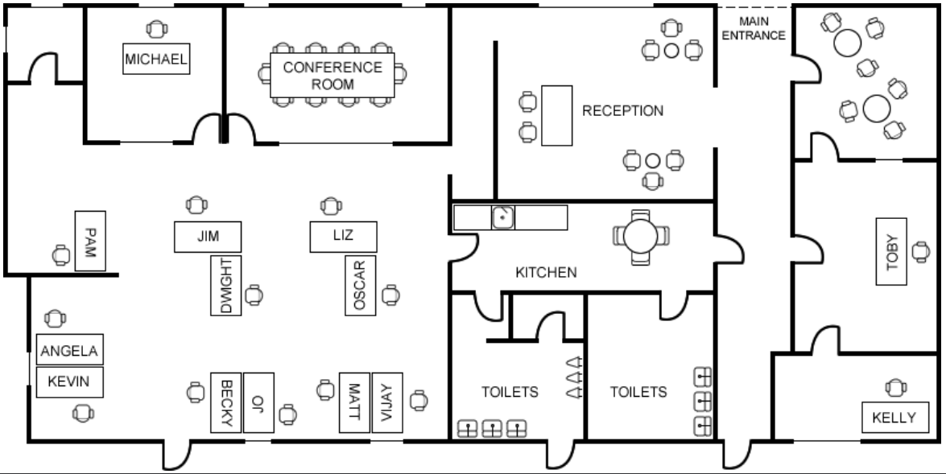
Types of networks

Slide 4
4. Getting to grips with terminology
Key terms task
An important aspect of being successful with your study of Computer Science is getting to grips with subject related terminology.
There are over 240 specific terms you will need to learn!
Below are a handful of the key terms you will need to become familiar with.
1. Research each of the key terms and write a definition, this will start a word bank of key terms that we will add to.
2. Resist the urge to simply cut and paste a definition from the first website you find. Many definitions found on The Internet are overly complicated and wordy.
3. Ask yourself:
• Does my definition make sense?
• Is it succinct, to the point?
• Does the definition have appropriate depth and detail for A’Level?
• Could I give this definition to another student so they could revise from it
Control Unit
Register Busses
Von Neuman Architecture
Optical Storage
Operating System
Intermediate Code
Device Driver
Compiler
Assembly Language
Machine Code
Lossy Compression
Hashing
Normalisation
TCP/IP
Stack
Packet Switching
ASCII
Problem Decomposition

