Slide 1
SPORT PROJECT
PART 2

Slide 2
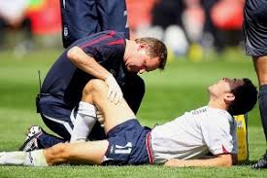
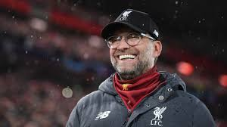
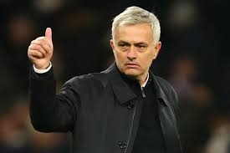
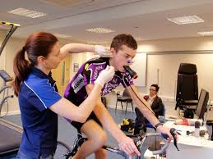
Introduction
FOR THE SECOND PART OF THE PROJECT YOU ARE GOING TO CONTINUE TO USE THE PROFESSIONAL SPORTS TEAM YOU SELECTED FOR THE FIRST PART AS THE BASIS FOR YOUR ANALYSIS.
The second project will look at ANOTHER 2 KEY areas: ‘careers in the sports industry’ and ‘leadership in sport’.
YOU WILL NEED TO DO SOME RESEARCH TO
COMPLETE THE TASKS. use the link on
each page as a starting point.

Slide 3
DEADLINES
Once you have completed the tasks you need to send them to either:
MR Stapleton - Taran.Stapleton@qka.education if applying for QKA
MRS brown – becky.brown@tda.education if applying for tda
By Friday 10th July

Slide 4
Careers in sport
In the case of all professional athletes whether they play a team sport or perform in an individual sport they will be supported behind the scenes by an array of different people including physiotherapists, coaches, managers, public relations, sports scientists, nutritionists and many more.
Task
For 3 of the careers that interest you the most (not the performer) find out the following:
What is their role? What do they do to support the performer?
What qualifications did they need to achieve?
How much can they earn in this role?
Are there any promotions they could get?
https://careers-in-sport.co.uk/jobs/ https://www.prospects.ac.uk/

Slide 5
Leadership in sport
A leader in sport can be anyone from the captain to the manager or coach, there may even be a player or coach in charge of defence and another in charge of the offence. All adopt varying leadership styles that suit them to try and get the best out of their team.
Task
Research the leadership styles on the next slide, give a short explanation of what each of them are and then discuss which fits a leader of your choosing within the team you’re analysing. Do you think this style gets the best outcomes? Compare them to another leader in sport you admire that uses a different style (doesn’t have to be from the same team). What is it about them that you think makes them a successful leader?

Slide 6
Leadership in sport
Situational leadership
Transformational leadership
Transactional leadership
https://www.youtube.com/watch?v=9ZsPVxq8wnU
https://www.informa.com.au/insight/leadership-styles-understanding-and-using-the-right-one-for-your-situation/
https://files.eric.ed.gov/fulltext/EJ1189931.pdf

