Slide 1
Name: | …………………………………………… | Primary School: | ……………………………………………
Tips and Advice
Below are some pieces of advice that will help you get to know TDA a little bit quicker.
SETTLING IN
At first the school might seem big, but it really is not. If you are not sure where to go or you get lost do not worry – just ask someone. Make a good first impression – be on time, be smart, be polite. You will see your Personal Tutor and other students in your Tutor Group every day and they will help you.
BEING ORGANISED
Be on time, school starts at 8.40 am and you need to be in the classroom, ready to learn, by then. Unless you have a good reason, like a note from your parents to explain why you are late, you will receive a late detention.
Make sure you get in the habit of going to the toilet at break and lunch. This might be quite a change from primary school but you need to think ahead. Being out of the classroom means you will miss important learning time.
Plan ahead – each evening go through your Student Planner and check Firefly, pack your bag lesson by lesson with all the things you will need for each class.
Check your timetable in the morning and make sure you have what you need – a drink, lunch, PE kit, school books, stationery ….
HOMEWORK
Write down your homework carefully. Try and complete the homework on the night it is set while the lesson is still fresh in your mind. Do not leave it until the last minute! If you really get stuck and do not know what you need to do, then see the teacher the next morning and explain your problem. They will not be annoyed if you do it this way, but they will be disappointed if you do not mention it before the lesson. Teachers will always be happy to explain again and may even get you started on the answers.
Some Year 7s are organised enough to get nearly all their homework done in Homework Club, so they have less work to do at home. Bonus! There are Homework Clubs that run at different times during the week.
MAKING FRIENDS
Everyone will feel worried about making new friends. Take the opportunity to talk to other students in your lessons and in your Tutor Group. After the first day decide where you are going to meet your friends at break and lunch so that you can always find them.
If you talk to Year 7s that started in September last year they will tell you how quickly they settled into the school and that they now have many friends. Please do not worry – if you have any concerns you can talk to your Personal Tutor or Student Support Officer.
EXTRA CURRICULAR CLUBS AND ACTIVITIES
We offer lunchtime and after school clubs and activities; this is a perfect way to make friends who have common interests and develop new skills.
Full details of the clubs and activities on offer will be available early in the Autumn Term. Information will be available on Firefly and through your Personal Tutor. Make sure your parents know what you are taking part in.
EQUIPMENT
A great deal of what you need will be provided for you. The essential items you will need to have include; a robust bag (usually a rucksack); pencil case – pens (including a green biro), pencils, sharpener, ruler, eraser, some basic Maths equipment (protractor, scientific calculator and a compass/pencil) and a separate bag for your PE kit.
NEVER BE AFRAID TO ASK FOR HELP

Slide 2
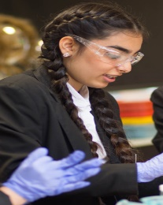
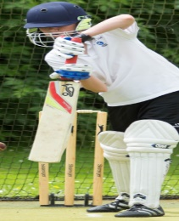

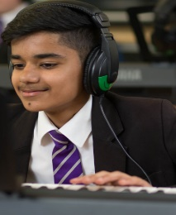
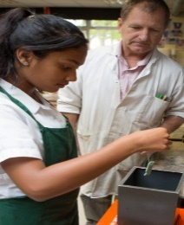
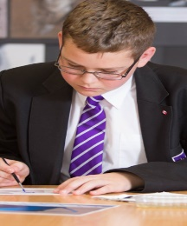
First Impressions
Name: | …………………………………………… | Primary School: | ……………………………………………
Did you know that a first impression is very hard to change?
We therefore need to make good first impressions and be aware that people will be getting a first impression of you!
Here are some top tips on making a good
first impression at secondary school:
Be you – people want honesty from their friends!
Don’t be afraid to make conversation.
Be nice – smile and look up.
Go to clubs that are to do with your interests – you’ll bond with people there.
Give it time – it takes time to make friendships!
Don’t force it – some things are not meant to be!
Be comfortable – meet people where you’ll both be comfortable and can properly chat.
Use your lessons – if you’re sitting next to someone, use it as a chance to chat (BUT NOT WHEN THE TEACHER IS OR WHEN YOU ARE MEANT TO BE WORKING).
What kind of friends do you want to have in secondary school? Make a list.
What kind of friend do you want to be to other people? Make a list.

