Slide 1


Slide 2
Aim
To learn about the work of Wassily Kandinsky and create a circles painting, using the colours I have mixed myself.
Alternatively, Create an image using concentric circles.
Success Criteria
I know how to mix colours, tints and shades.
I can use colours to paint/colour a circles painting.
I can tell you an interesting fact about Wassily Kandinsky.
I can tell you about one of Kandinsky’s paintings.

Slide 3


Colour Mixing

Slide 4


Primary Colours
These are the primary colours.

Slide 5

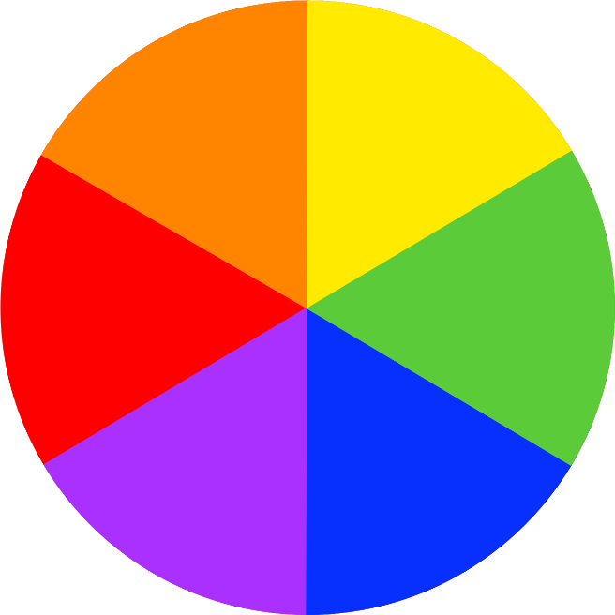
Secondary Colours
These are the secondary colours.
You use the
primary colours
to mix these.

Slide 6




Mixing Secondary Colours

Slide 7
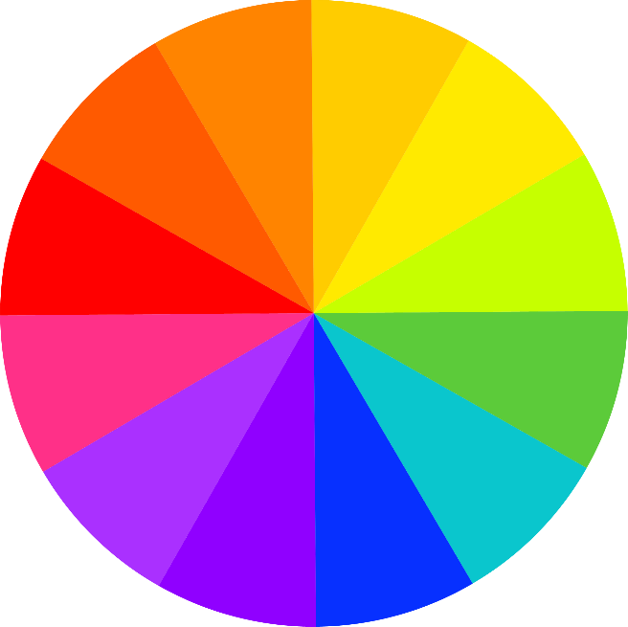
Mixing Secondary Colours
We have practiced mixing lots more colours!

Slide 8
Neutral Colours
These are neutral colours.

Slide 9






Mixing Tints
If we add white to a colour, we can make tints.
This makes a colour lighter.

Slide 10






Mixing Shades
If we add black to a colour, we can make shades.
This makes the colour darker.

Slide 11
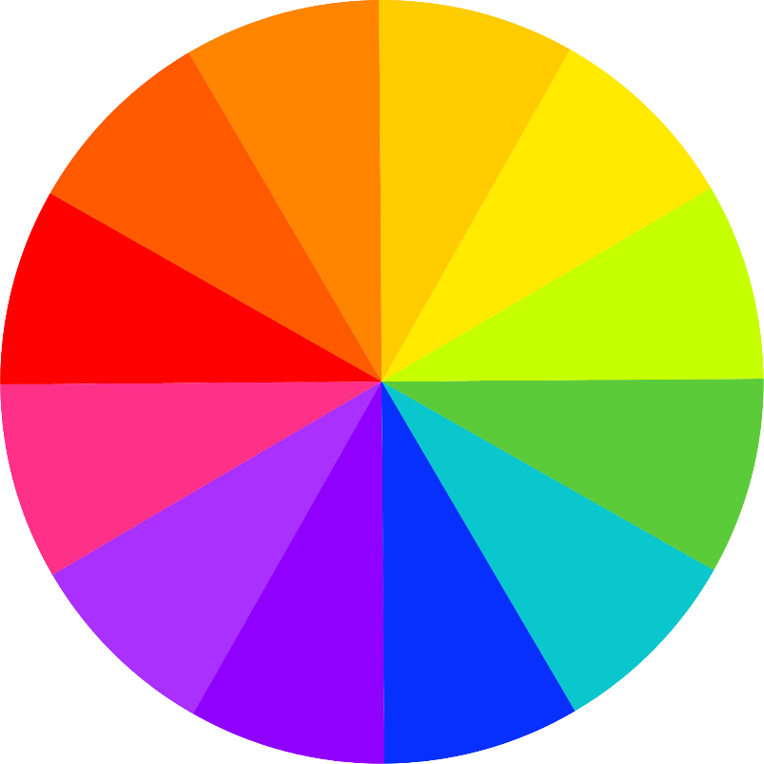
Warm and Cool Colours
These are warm and cool colours.
warm colours
cool colours
-----------------------------

Slide 12
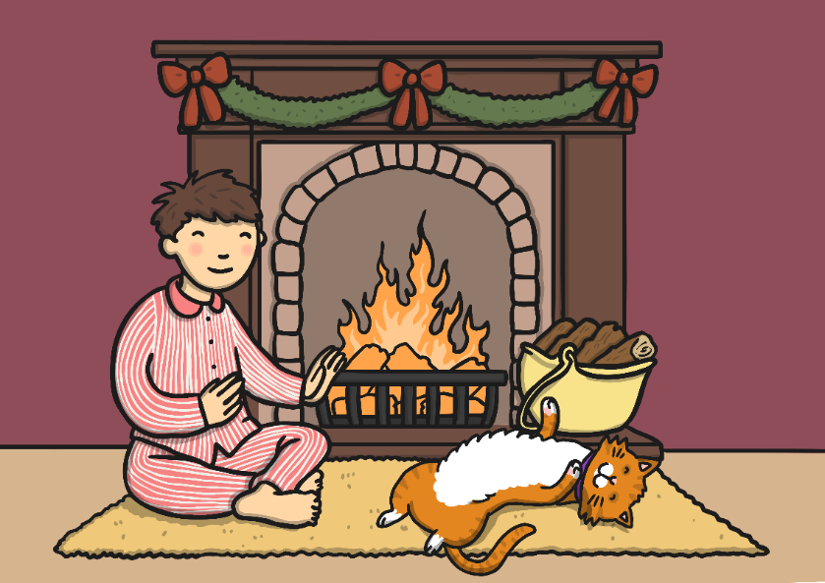

Warm Colours
Cool Colours
Red, orange, and yellow are warm colours. They make us think of sunny, warm and cosy things.
Green, blue and purple are cool colours. They make us think of fresh, calm and chilly things.

Slide 13


Using Every Colour
Today we are going to use all the colours!

Slide 14
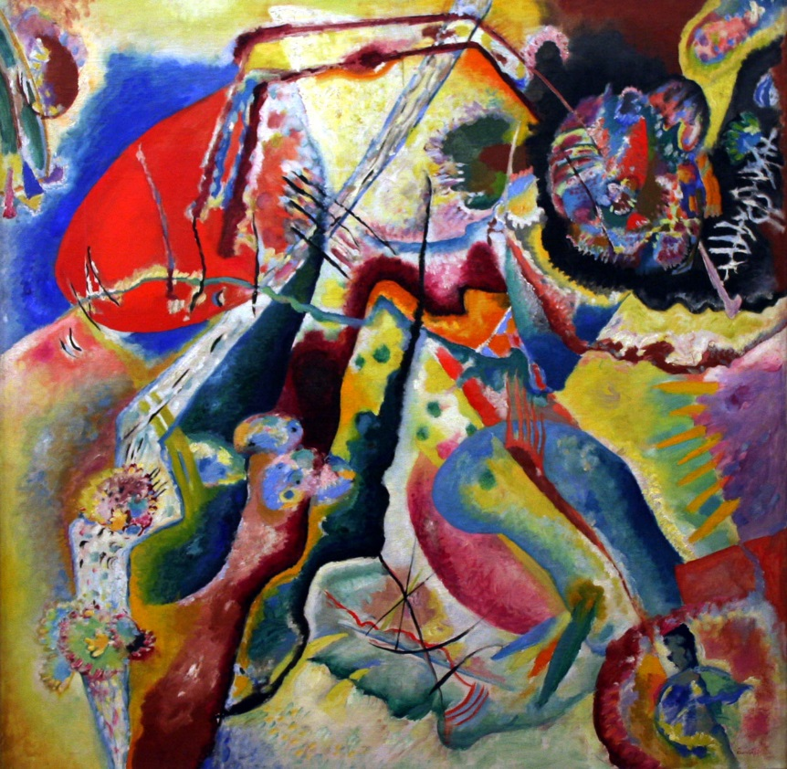
Wassily Kandinsky
Wassily Kandinsky was
a Russian painter.
Many people think he was
the first abstract artist.
Abstract Painting
by Wassily Kandinsky
Photo courtesy of Playing Futures: Applied Nomadology (@flickr.com) - granted under creative commons licence – attribution

Slide 15
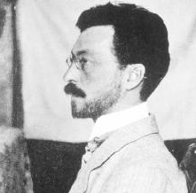
All about Wassily Kandinsky
(1866 - 1944)
Russian
Wassily Kandinsky was born in Russia, in 1866. When he grew up, he worked as a teacher at a university but it didn’t make him happy.
When he was 30, he left his job and went to art school. He found art school easy and was very good at his studies.
Kandinsky thought a lot about what colours mean and how they make people feel. He believed that colours had a soul.
Wassily Kandinsky

Slide 16





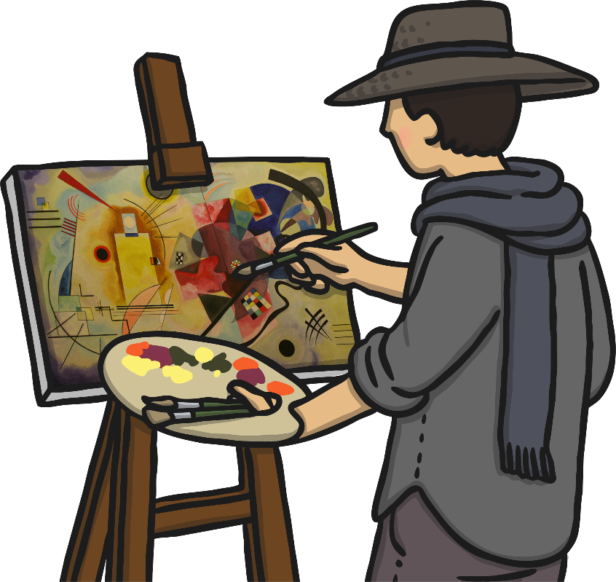
All about Wassily Kandinsky
(1866 - 1944)
Russian
He was the first painter to stop painting pictures of things and instead paint just using colours and shapes. He believed that this let him paint honestly about his feelings.
Often Kandinsky would listen to music while he painted and try to paint what he heard.
All the other painters we have found out about learned a lot from Kandinsky’s ideas.

Slide 17
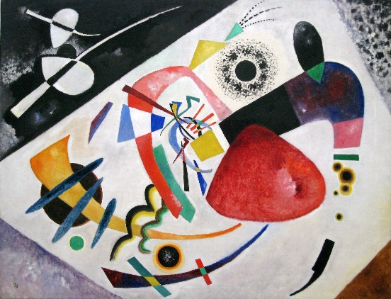
Red Spot II (1921)
by Wassily Kandinsky
Photo courtesy of Sharon Mollerus (@flickr.com) - granted under creative commons licence – attribution

Slide 18
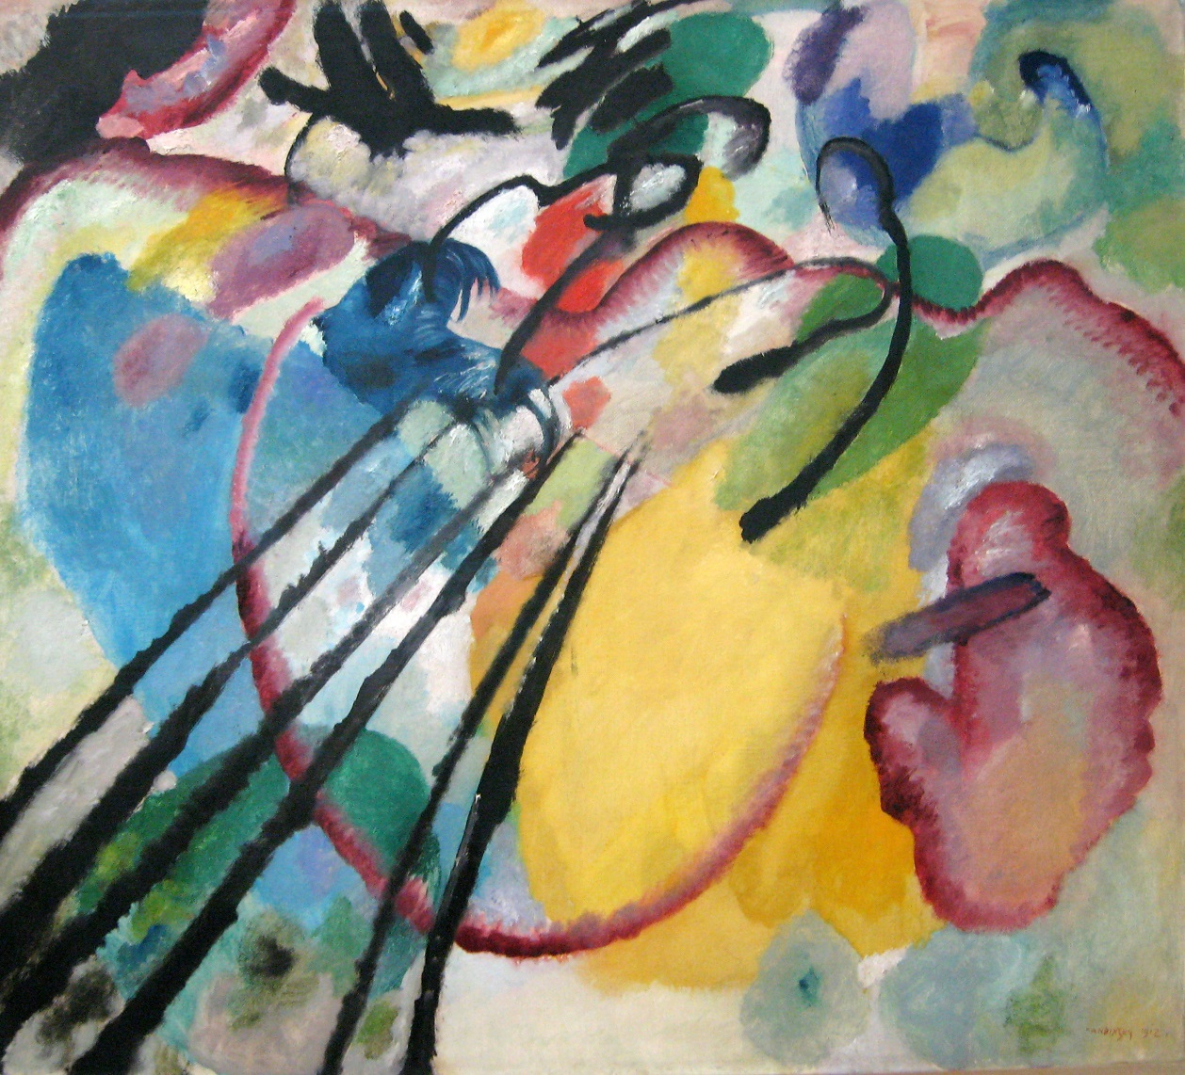
Improvisation 26 (Rowing) (1912)
by Wassily Kandinsky
Photo courtesy of Sharon Mollerus (@flickr.com) - granted under creative commons licence – attribution

Slide 19
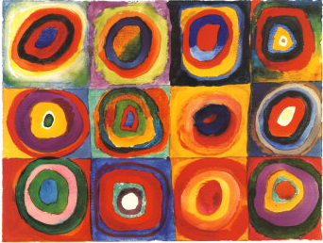
Colour Studies: Squares with Concentric Circles
by Wassily Kandinsky
Photo courtesy of NailsandNoms (@flickr.com) - granted under creative commons licence – attribution

Slide 20

Looking at Abstract Art:
Colour Studies: Squares with
Concentric Circles (1913)
What do you see when you look
at this painting?
How has the painting been made?
What kind of colours does Kandinsky use?
How would you describe these colours?
What shapes can you see?
What kind of lines can you see?
How do you think Kandinsky was feeling when he painted this?
How does the painting make you feel?
Do you like it? Why?
Photo courtesy of NailsandNoms (@flickr.com) - granted under creative commons licence – attribution

Slide 21
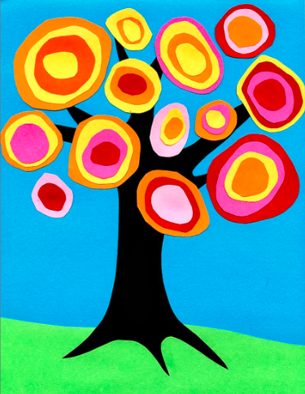
You are going to draw or paint either one of these.
Photo courtesy of NailsandNoms (@flickr.com) - granted under creative commons licence – attribution

Slide 22










Kandinsky Circle Painting
You will need…
A3 painting template
Paint in lots
of colours
Brushes
Water
A rag
Experiment with mixing colours together. Use white to make them lighter, and black to make them darker. Practice until you have lots of colours that you like.
In each square of your template, paint a dot. Use a different colour for each one.
Remember: Swish, wipe and blot!
Round each dot, paint a circle in a different colour.
Round each circle, paint an even bigger circle in a new colour.
Finally, fill in any white space you have left in each square in another colour.

Slide 23
Kandinsky Style Tree Painting
You will need…
Paper
Paint in lots
of colours
Brushes
Water
A rag
Sketch a tree trunk.
On each of the branches, paint or draw a dot. Use a different colour for each one.
Remember: Swish, wipe and blot!
Round each dot, paint a circle in a different colour.
Round each circle, paint an even bigger circle in a new colour.
Finally, fill in any white space you have left in the background colour.

Slide 24
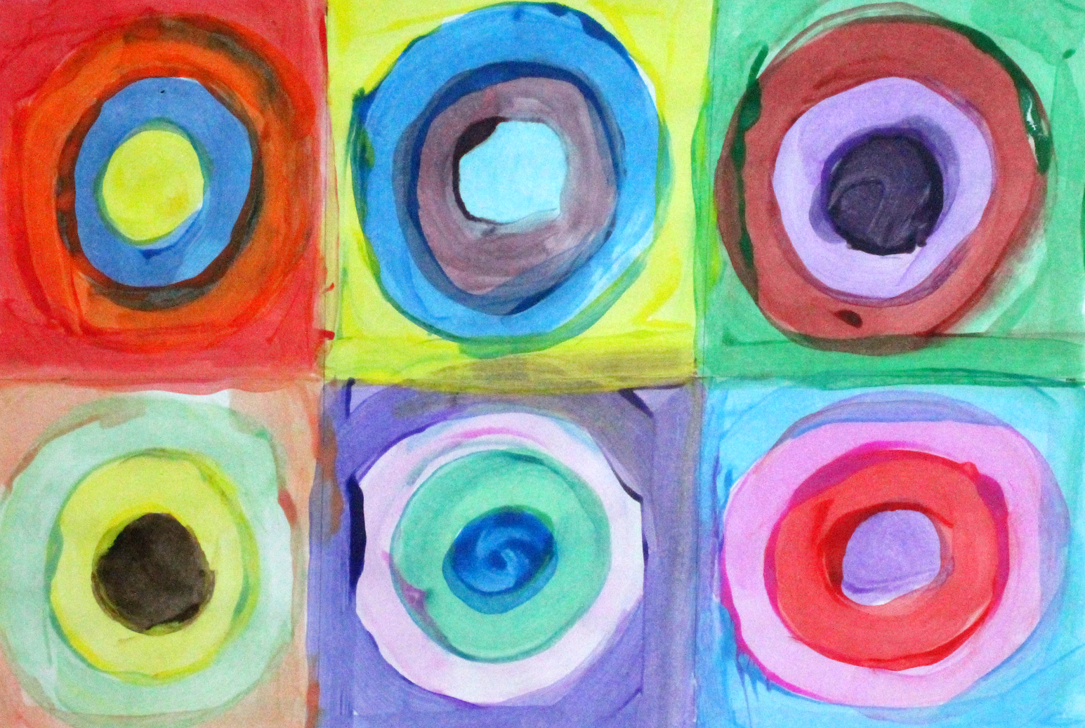
What a good circle painting looks like…

Slide 25



Celebrating Your Artwork!
Share your picture with Mr Noyes
Look at the painting or drawing that you have created.
Think about your painting.
What feeling do you think that
your painting shows?

Slide 26
