Slide 1


Thomas Deacon Academy
Geography Department
The Big Picture:
How are rocks created? How important are they and landforms they produce?
Prior Learning:
What are the three types of rock?
How does weathering happen?
Where did Britain's rocks come from?
Why is Limestone scenery so distinctive?
Should we be quarrying?
How dangerous are rock falls?
Current Learning:
How were the Dartmoor Tors formed?
Write this as your title
Future Learning:
What is the Giant’s causeway like?
Assessment
Learning Objectives
You will be able to:
Locate and describe the Dartmoor Tors
Explain how the Tors were formed, in writing and with a diagram
Suggest how the Tors are used by people
Key terms:
Write these in your margin
Tor Weathering
Erosion Dartmoor

Slide 2
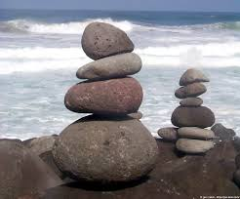
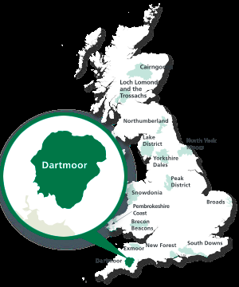
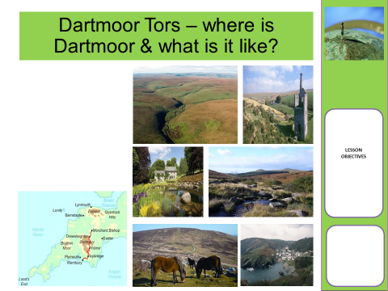
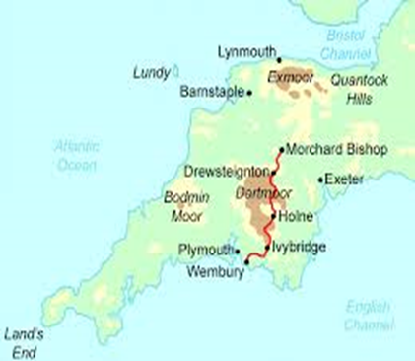
Look at the photos and watch the video clip. Write a paragraph to explain where Dartmoor National Park is, and describe what it is like.
https://www.youtube.com/watch?v=adR8JJj2NMM
ROCKS
How were the Dartmoor Tors formed?
Learning Objectives
You will be able to:
Locate and describe the Dartmoor Tors
Explain how the Tors were formed, in writing and with a diagram
Suggest how the Tors are used by people

Slide 3
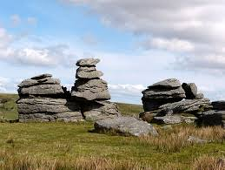
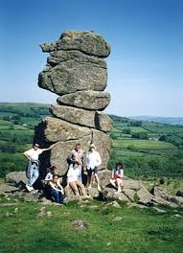
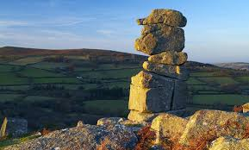
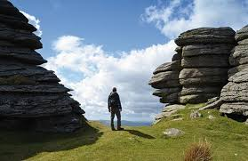
What is A Tor? Write a definition.
ROCKS
How were the Dartmoor Tors formed?
Learning Objectives
You will be able to:
Locate and describe the Dartmoor Tors
Explain how the Tors were formed, in writing and with a diagram
Suggest how the Tors are used by people
A high rock or pile of rocks at the top of a hill
A high hill, especially a rocky one
A rocky pinnacle
Faster finishers: how do you think these tors were formed?

Slide 4
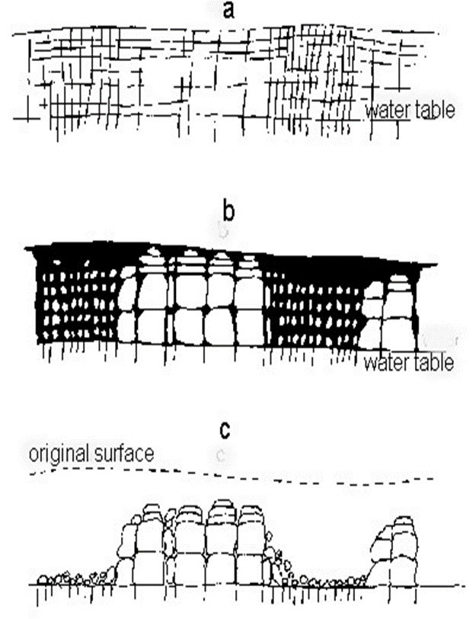
How are Tors formed?
Task: Draw a sequence of diagrams to show how Tors were formed. Then write a detailed explanation of the process.
(You may need to research this as your teacher would have explained the diagrams to you!)
ROCKS
How were the Dartmoor Tors formed?
Learning Objectives
You will be able to:
Locate and describe the Dartmoor Tors
Explain how the Tors were formed, in writing and with a diagram
Suggest how the Tors are used by people
Step 1 | I can draw diagrams to show a sequence
Step 2 | I can use geographical vocabulary
Step 3 | I can describe the causes of an event
Step 6 | I can explain the causes of an event

Slide 5
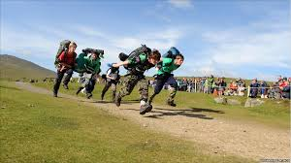
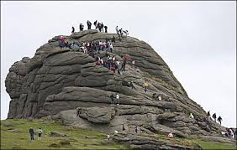
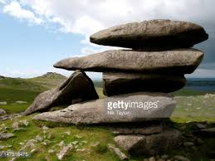
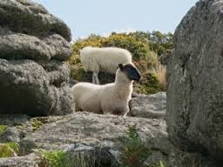
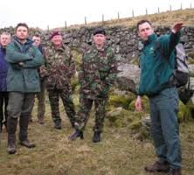
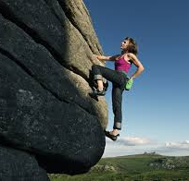
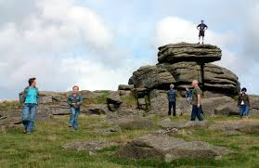
How are Tors used?
D of E
Art
Tourism
ROCKS
How were the Dartmoor Tors formed?
Army Training
Farming
Extreme sports
Fieldwork
Learning Objectives
You will be able to:
Locate and describe the Dartmoor Tors
Explain how the Tors were formed, in writing and with a diagram
Suggest how the Tors are used by people
Task: Write a spider diagram showing how tors can be used.
Faster finishers: explain whether you would like to visit a tor or not.

Slide 6
Closing Activity – a pile of old rocks?
Are Tors an exciting part of the natural landscape, or just a pile of old rocks?
ROCKS
How were the Dartmoor Tors formed?
Learning Objectives
You will be able to:
Locate and describe the Dartmoor Tors
Explain how the Tors were formed, in writing and with a diagram
Suggest how the Tors are used by people
Write a 50 word answer to the question above.
You must use these words in your answer : tor, important, Dartmoor

