Slide 1

Thomas Deacon Academy
Geography Department
The Big Picture:
What happens in our atmosphere?
Prior Learning:
What is the difference between weather and climate?
Which factors affect weather and climate?
Why does it rain?
What causes microclimates?
Assessment
Current Learning:
What is Britain’s weather like?
Write this as your title
Future Learning:
Why do we have extreme weather?
How bad is climate change?
Learning Objectives
You will be able to:
Identify the trends in Britain's weather and explain why they happen
Understand the causes and effects of a storm event
Key terms:
Write these in your margin
Seasons Equator
Storm Impacts
North Atlantic Drift

Slide 2

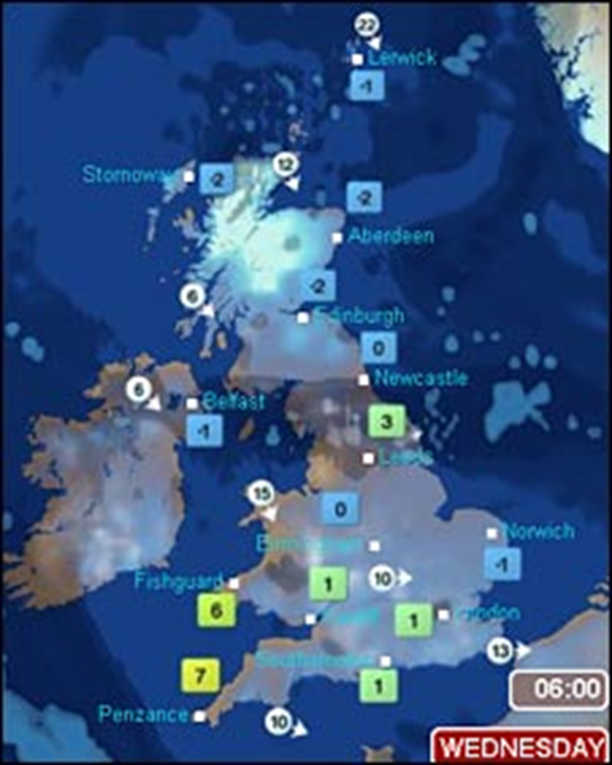
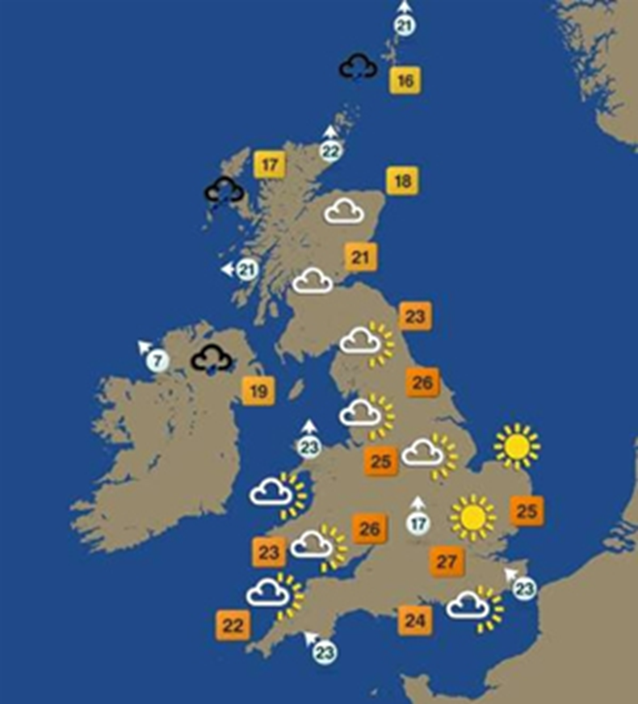

Opening Activity – weather forecasts
Is the weather the same for the whole of Britain?
Stretch yourself:
What is the weather in Peterborough like according to these maps?

Slide 3
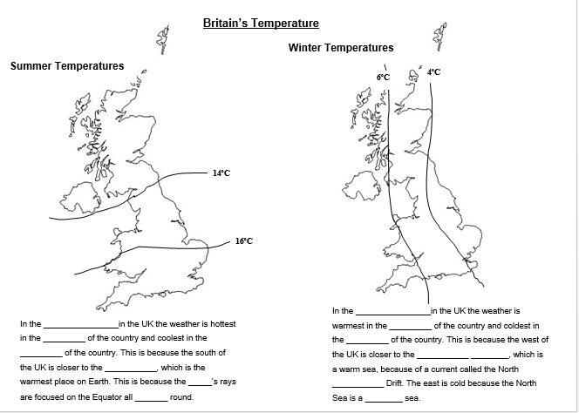
Your Task
Colour 2 maps to show the temperature patterns
Fill in the gaps with the words from the word box below
Word Box:
Summer Sun Atlantic Ocean Winter Atlantic East Cold Equator West North Year South
Stretch yourself: Which factors that influence climate are most significant in Britain's climate?

Slide 4
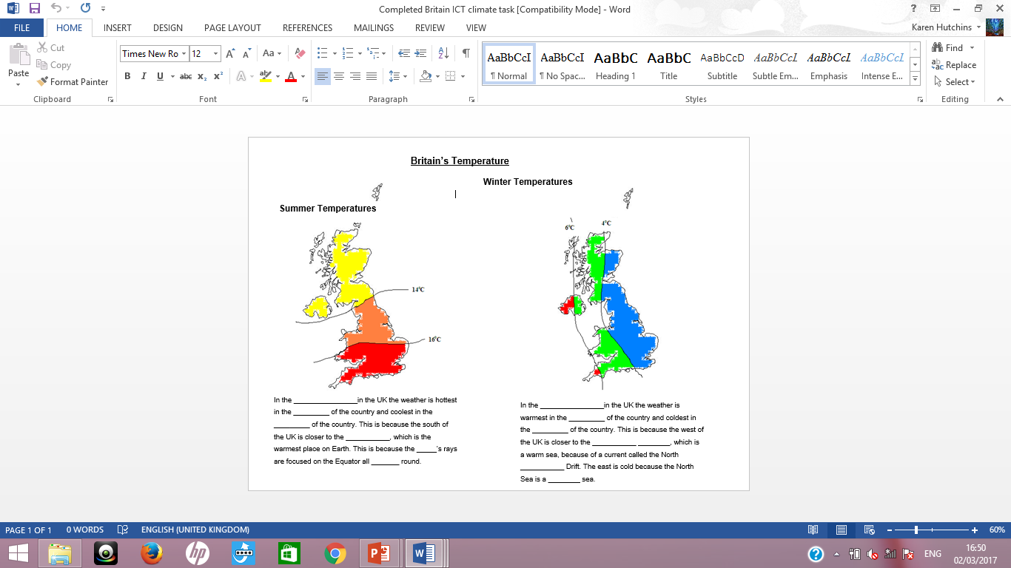
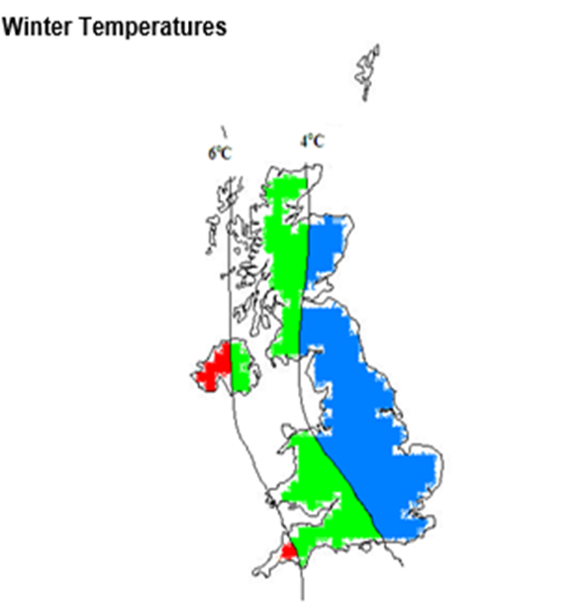
Your Task - answers
Summer
Winter
South
West
East
North
Atlantic Ocean
equator
sun
Atlantic
year
cold

Slide 5
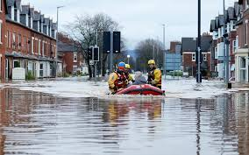
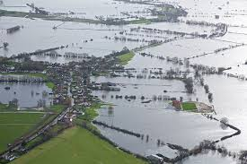
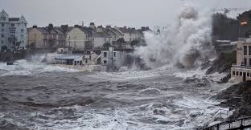
But is Britain’s weather always the same?
In Britain we are used to cold and wet weather in winter, but the winter of 2013/14 was worse than usual
It bought:
- the worst storms for 20 years
- more days with severe gales than the previous 140 winters
-more rain than the previous 250 winters
- over £1 billion damage from rain & wind
Read through the news article about Storm Desmond (2015) and answer the 4 questions on your sheet; try to give as many specific details as possible

Slide 6
Research Task
Choose one of the weather events to research - investigate the causes, effects and responses to the weather event.
Make sure you have specific facts and include numbers where you can e.g. 10 people were killed, the repairs cost £17 million etc.
Create your own newspaper article about the event; you can add maps, pictures, interviews with people etc. You can choose from:
- Heatwave July 2019
- ‘Beast from the East’ (snow) 2018
- ‘The Great Storm’ (hurricane winds) 1987

Slide 7

Closing activity
What is Britain’s weather like?
Answer the title question. Give as much detail as you can, and remember to use today’s key terms!
Seasons Equator
Storm Impacts
North Atlantic Drift

