Slide 1
Thomas Deacon Academy
Geography Department
The Big Picture:
What is the future for the Middle East?
Prior Learning:
What are the human and physical features of the Middle East?
What is the climate of the Middle East?
How do plants and animals live in the desert?
How is the population distributed across the Middle East?
How important are the Middle Eastern oil reserves?
What has caused the Syrian conflict?
Current Learning:
Should Qatar host the 2022 World Cup?
Write this as your title
Future Learning:
Will the Middle East have water wars?
Assessment
Key terms:
Write these in your margin
FIFA Host
Culture Human rights
Controversy

Slide 2
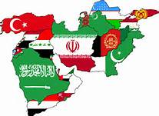
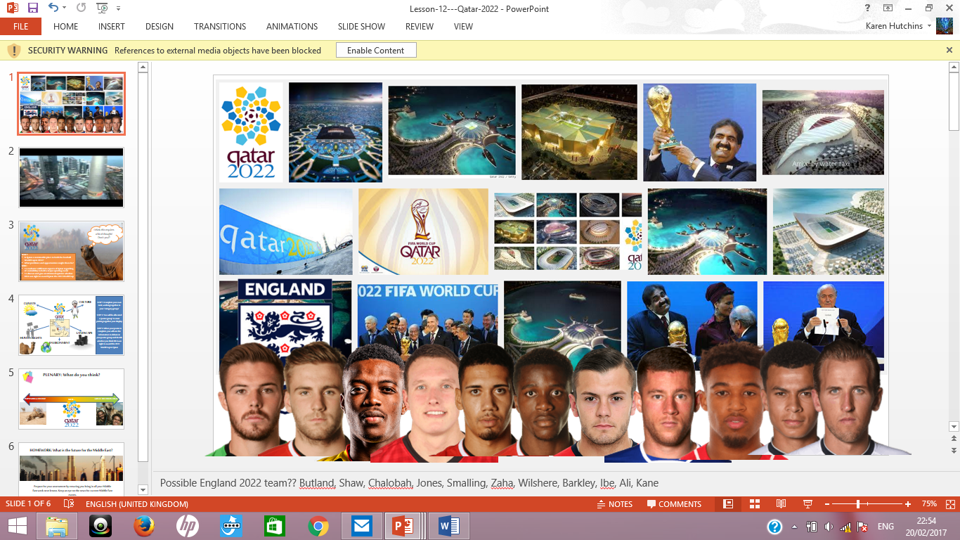
Opening Activity – What do you know?

Slide 3
Why does Qatar believe it would be a good host nation?
https://www.youtube.com/watch?v=xI2v9AKV08Q
Easy international air travel
Modern facilities
Good security
Good transport network
Compact site
Clean/attractive environment
Traditional aspects
Extension: How reliable are these artists impressions?
https://www.youtube.com/watch?v=oM0Je0MLVI0

Slide 4
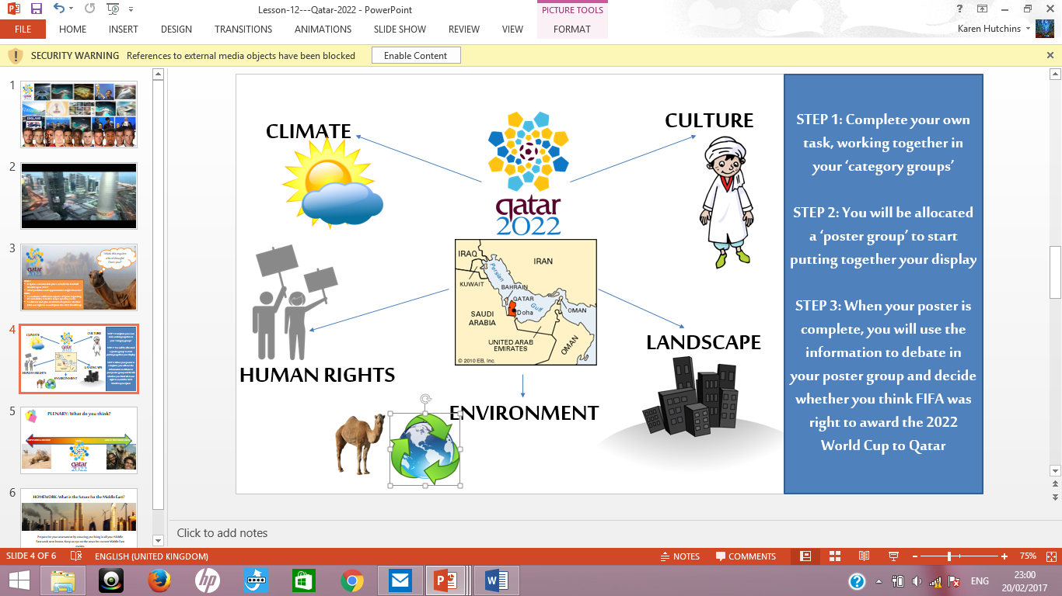
Your Task
Examine each of the aspects – make sure you all understand the information

Slide 5
Your Task
Decide whether FIFA made the right decision selecting Qatar as the host nation
Explain your decision

Slide 6
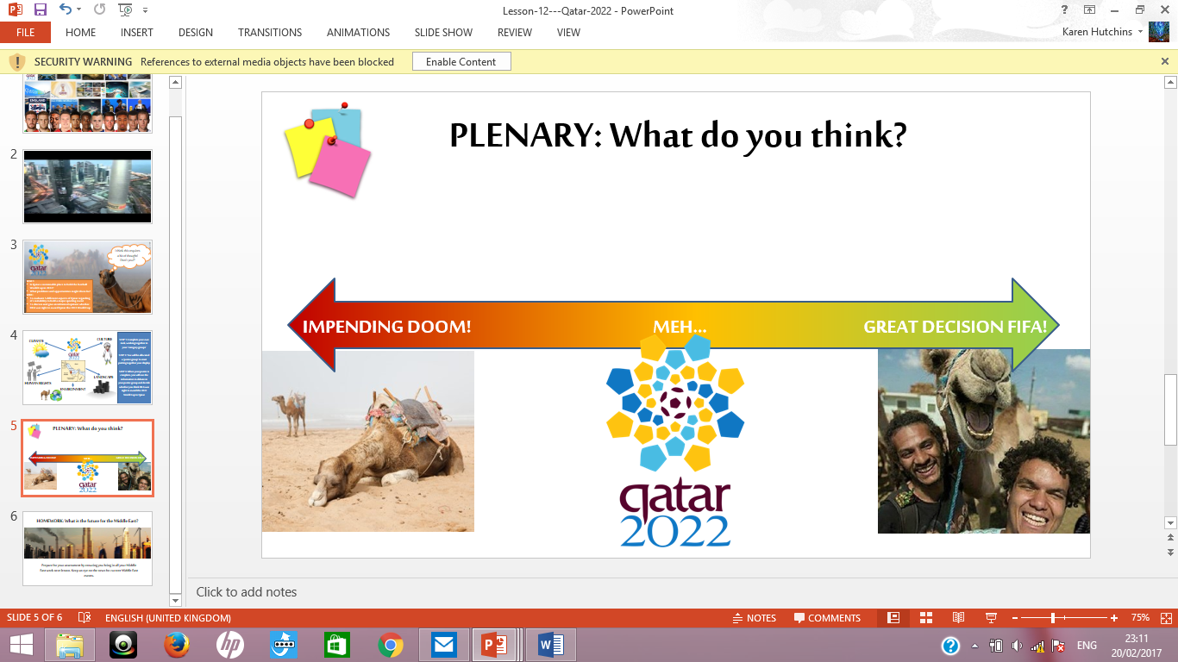
Opinion Line

Slide 7

Closing activity
Should Qatar host the 2022 World Cup?
Answer today’s title question. Give as much detail as you can, and remember to use today’s key terms!
FIFA Host
Culture Human rights
Controversy

