Slide 1
A Raisin in the Sun Home Learning
Anything you need to do/ answer is highlighted in yellow and numbered so that you submit your work clearly labelled
Work your way through at a steady pace – it does not all need completing until Friday 17th July
Try to read some of the Reading List as well
Keep an eye on Teams/ emails in case we set anything else for you to do

Slide 2
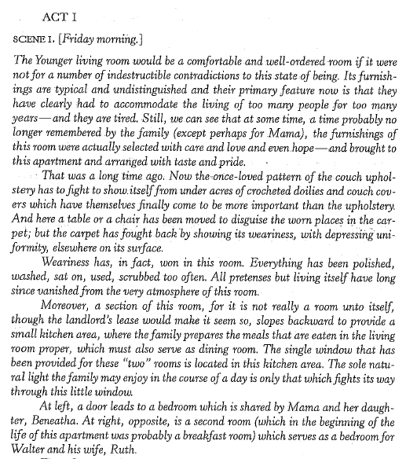

Slide 3
Read the rest of Act 1 Scene 1

Slide 4
Ruth Younger
What key details do we learn about Ruth in Act 1, Scene 1?
‘We can see that she was a pretty girl … but now it is apparent that life has been little that she expected, and disappointment has already begun to hang in her face.’
1

Slide 5
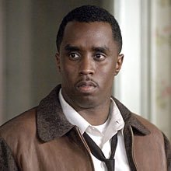
Walter Younger
2
What key details do we learn about Walter in Act 1, Scene 1?

Slide 6
Ruth & Walter’s Relationship
‘What’s the matter with you?’
‘Ain’t nothing the matter with me. And don’t keep asking me that this morning.’
‘First thing a man ought to learn in life is not to make love to no coloured woman first thing in the morning. You all some evil people at eight in the morning.’
‘You couldn’t be on my side that long for nothing, could you? … A man needs for a woman to back him up …’
‘(mumbling) We one group of men tied to a race of woman with small minds.’

Slide 7
Essay Practice
3
How have social expectations affected Ruth and Walter?
AO1
Apply concepts and methods from integrated linguistic and literary study as appropriate, using associated terminology and coherent written expression (a well-ordered and coherent argument)
AO2
Analyse ways in which meanings are shaped in texts
AO3
Demonstrate understanding of the significance and influence of the contexts in which texts are produced and received

Slide 8
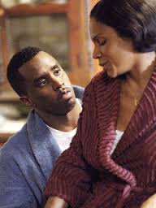
Walter & Ruth
4
How would you describe the relationship between Ruth and Walter in the first section of the play?
How are they affected by social depravity?
5

Slide 9
Exploring Identity
6
How much of your identity is tied up in these controlling factors?
Social Status
Wealth
Culture
Appearance
Language
Family
Education
Mannerisms

Slide 10
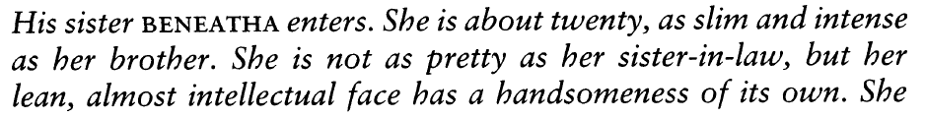
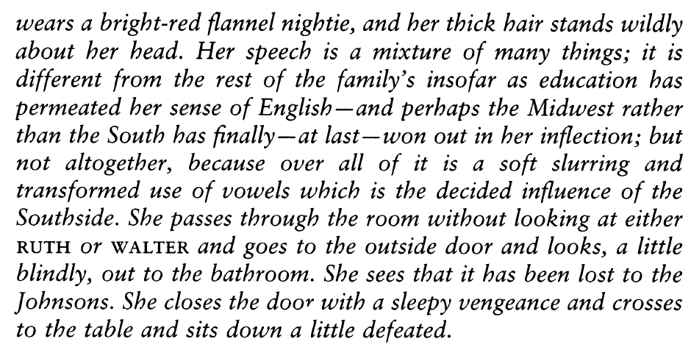
What do we learn about Beneatha Younger from the literary devices Hansberry uses to describe her?
7

Slide 11
What do we learn about Beneatha Younger from the literary devices Hansberry uses to describe her?
This first introduction to Beneatha is almost otherworldly, she is intense and uniquely attractive
Her hair is wild and we can envisage a burst of red in a dingy apartment
Her voice is a ‘mixture of many things’ giving it a uniqueness
She ‘passes through the room’ like a ghost without acknowledging Ruth or Walter
Beneatha seems to lack a definitive identity.
Why might that be a good thing?
8

Slide 12
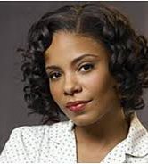
Beneatha Younger
9
How does Beneatha compare to the other two main characters?
List your ideas. Think about how she behaves, her views, and reactions
E.g. When she sees the bathroom has been taken, she sits down a ‘little’ defeated and waits.
  2. How does disappointment manifest with Ruth?
  3. How does Walter react to the busy bathroom?
  4. Beneatha has dreams of a more fulfilling life, like Walter. But how is her approach to achieving those dreams different to his?

Slide 13
Beneatha & identity quotes. How far is Beneatha an outsider?
10
Individually I’d like you to find two key quotations that convey the above.
You must consider the techniques you could comment on…not just a random quote!
Any the same? Let’s find different ones.
Let’s place them in order of importance.
Use this as the basis of your forthcoming essay.

Slide 14
PETAL – How does Beneatha differ from Walter/Ruth?
11
POINT – What is your first idea?
EVIDENCE – Reference a specific part of the text to support your ideas
TECHNIQUE – Are there any key words or language techniques that give greater meaning to your chosen quote?
ANALYSE – Explain your ideas and look for meaning beyond what is obvious – ask yourself why Beneatha is different
LINK to context and back to the question

Slide 15
Essay practice - How does Beneatha represent a changing society?
12
POINT – What is your first idea?
EVIDENCE – Reference a specific part of the text to support your ideas
TECHNIQUE – Are there any key words or language techniques that give greater meaning to your chosen quote?
ANALYSE – Explain your ideas and look for meaning beyond what is obvious – ask yourself why Beneatha is different
LINK to context and back to the question

Slide 16

Making links to Gatsby
How are Nick and Beneatha presented as outsiders from society?
13

Slide 17
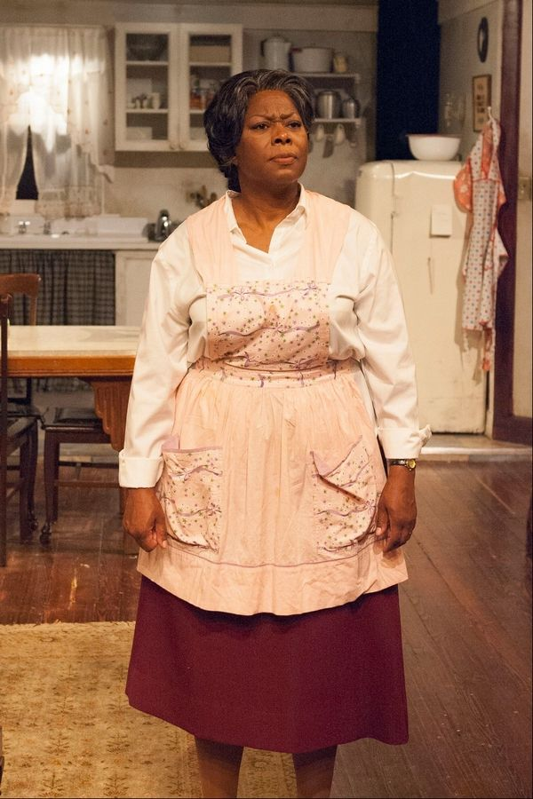
Mama

Slide 18

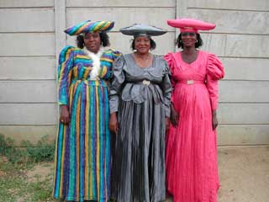
Mama (Lena) Younger
*The Herero are an ethnic group inhabiting parts of Southern Africa.

Slide 19
Quotation Analysis (AO1 & 2)
‘Well – he’s a little boy. Ain’t supposed to know ‘bout housekeeping.’ (p24)
‘We ain’t no business people, Ruth. We just plain working folks.’ (p25)

Slide 20
Quotation Analysis (AO1 & 2)
‘But Lord, child, you should know all the dreams I had ‘bout buying that house and fixing it up and making me a little garden in the back – (She waits and stops smiling.) And didn’t none of it happen. (She drops her hands in a futile gesture.)’ (p28)

Slide 21
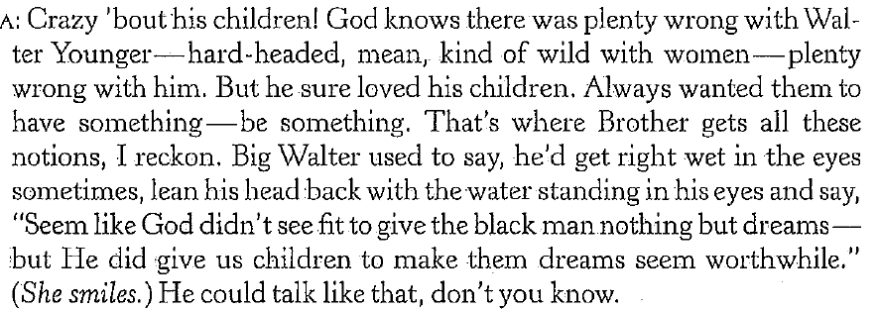
Mama and her late husband Big Walter’s dream of owning a home forms the crux of the play. Clinging to a dream deferred for nearly 35 years, Mama recalls Big Walter’s statement that it seems “like God didn’t see fit to give the black man nothing but dreams,” linking the postponement of her dream to racial inequality. Ironically, it is Big Walter’s death, with its resulting $10,000 insurance payment, that makes the realization of Mama’s dream possible by the end of the play.

Slide 22
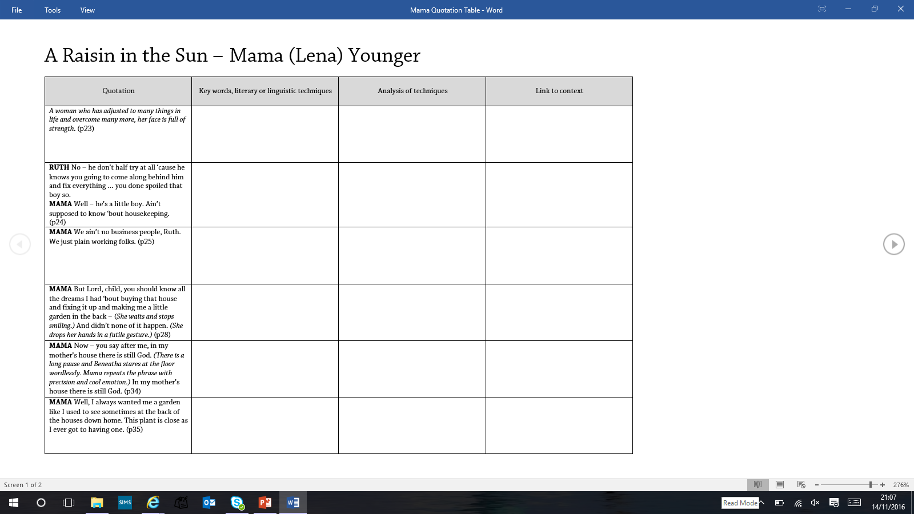
Task: Using the table, analyse the character of Mama (Lena) Younger.
14

Slide 23
Complete this comparison table of key points about these 2 characters
15
Mama Younger | Beneatha Younger
Traditional Woman | Modern, independent woman who does not rely on anyone
 | Does not believe in God, and believes that mankind is responsible for his own destiny

Slide 24

How has Hansberry used Beneatha and Mama to present a changing society?
16
Surface Meaning
It is not enough to just say the ways that these two characters are different.
… you must say WHY they are different.
e.g.
Why does Mama believe in God?
Why does she accept her husband’s womanising?
Analysis
Hansberry has presented both Mama and Beneatha in a positive light – even though they represent very different ideas.

Slide 25
CONTEXT: Assimilationism & Anti-Assimilationism
Assimilationism = The act of encouraging minority cultural groups to be similar to larger cultural groups, often at the cost of suppressing their own cultural habits.
ANTI-Assimilationism = The idea that minority groups should not have to adhere to their new country’s norms and do everything in the same way e.g. clothing, food. Their own culture is kept and celebrated.
17
How is this theme presented in the play?

Slide 26
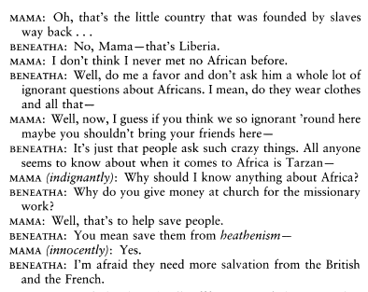
Opinions on African culture
18
What is Hansberry trying to achieve with this scene?
Heathenism - The practice of a people that do not acknowledge the God of the Bible.
French and British Colonial Styles
People in Africa were burdened by colonial perceptions of who they were. The British believed Africans were essentially different from Europeans and would stay that way. This point of view invited racism, implying that Africans were not just different but also inferior.
The French, by comparison, were prepared to treat Africans as equals, but only if they learnt to speak French properly and adopted the values of French culture. If they reached a sufficient level of education Africans might be accepted as French citizens. To fall below the required level was to invite charges of racial inferiority.

Slide 27
AO3 Contemporary Views
Hansberry uses this scene to express her dissatisfaction with most people’s distorted perceptions about Africa. In 1959, all that most people knew about Africa was via the broadcasts from the various colonial rulers and/or the Hollywood messages contained in Tarzan movies.
It is also interesting to note just how American Mama views herself, in opposition to how the majority of Americans view her.

