Slide 1
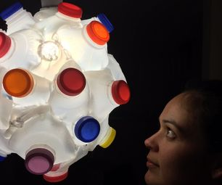
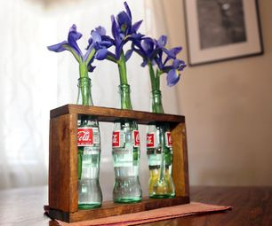
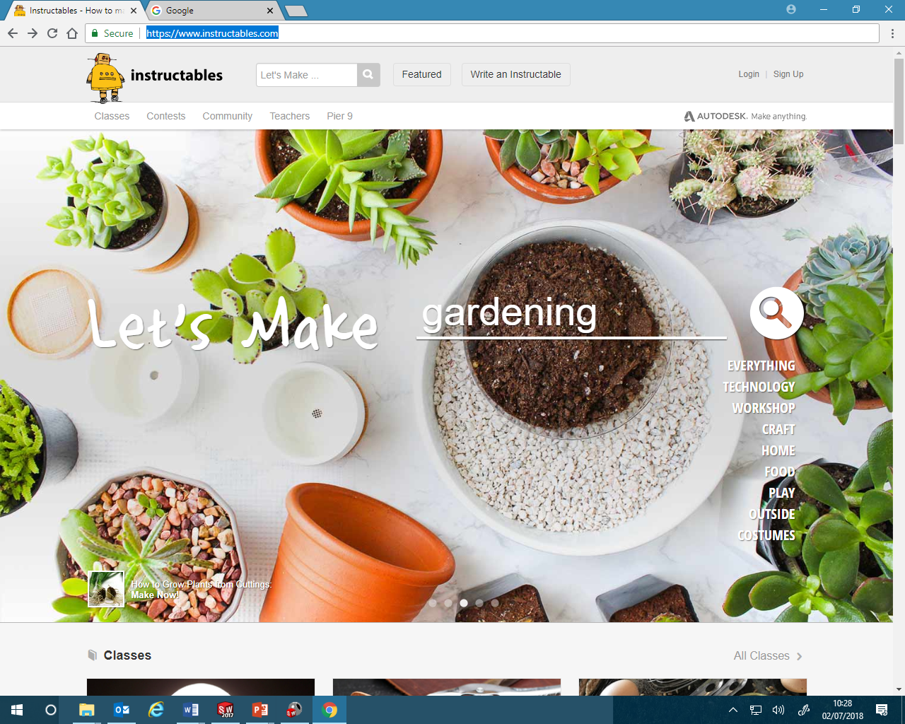
Independent making project (https://www.instructables.com/)
Go to the instructables website and choose a project that you can complete at home in 6 weeks.
Consult your parents or carers and choose a project that you have the tools and materials to make at home, some projects on the site can be done with a pair of scissors and some glue others may need special equipment that you do not have. Allot of the Upcycling projects use things you would throw away so will make the project cheap or even free and customising existing products is also an option
Your homework's for the next 8 weeks will be to bring
Photographs that report on your progress and bring in
your finished product

Slide 2
Homework 1 Learning aims
1: | Choose 3 projects that you want to do
2: | Agree them with your parents
3: | Put print screens of the chosen products on this slide so your teacher can check you have chosen a realistic project and help you select one.

Slide 3
Homework 2 Learning aims
1: | Gather all the materials and equipment you require
2: | Take a photo of everything you need laid out neatly
3: | Paste the picture on this slide and annotate (label) the materials and equipment

Slide 4
Homework 3 Learning aims
1: | Put 4 photographs of your progress on this page
2: | Annotate the processes and materials
3: | Explain what each part will do when you have finished

Slide 5
Homework 4 Learning aims
1: | Take a photograph of your finished projects
2: | Annotate or label the functions and materials
3: | Annotate / List the good and bad parts of your project. Does it work? Does it look good? What would you improve if you started again? Is there a better material it could be made from? Are there better methods that you could use?

