Slide 1
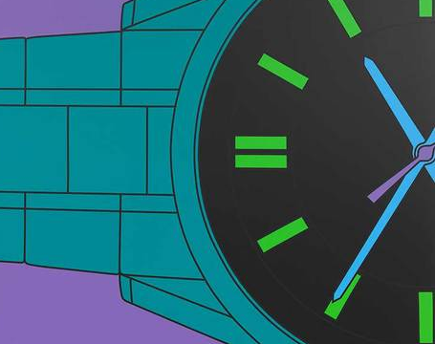
Art Detective
Michael Craig Martin

Slide 2
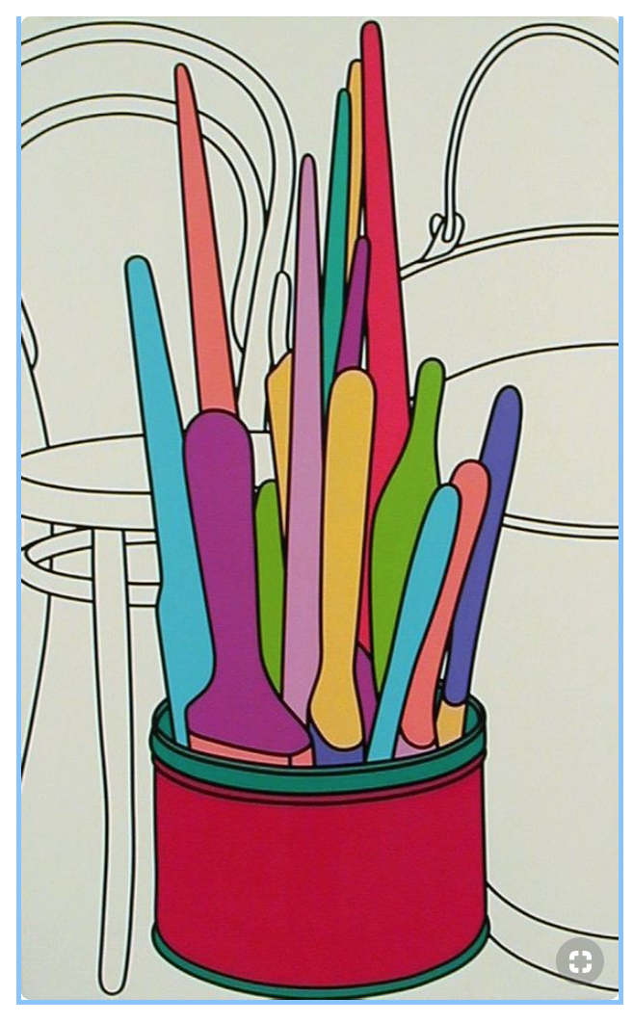
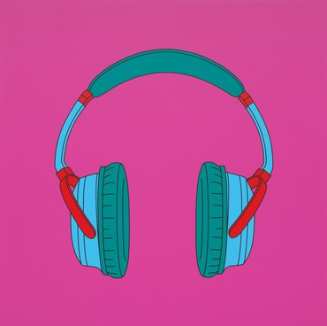
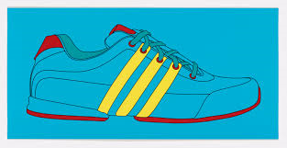
Task 1 Complete at least an A4 page of writing, analysing, in your own words one piece of work by Michael Craig Martin.
Include the image either by printing it off in colour or copying it as a drawing. The image can be of your choice, but must be by Michael Craig Martin.
Yr 9
Michael Craig
Martin

